Slide 1
Samsung Innovation Campus
Artificial Intelligence Course
Notes:
Note:
1

Slide 2
Employee Future Prediction
Project presented by :
Marwan Mohamed
Marwan Makhlouf
Mohamed Sameh
Data Used : Employee Future Prediction(Kaggle)
Notes:
Note:
2

Slide 3
Agenda
1- About Data
2- Preprocessing
3- EDA and Data Visualization
4- ML Model
5- Business Solution
Notes:
Note:
3

Slide 4
About data
A company's HR department wants to predict whether some employees would leave the company in next 2 years.
Our job:-
Our job is to build a predictive model that predicts the prospects of future and present employees.

Slide 5
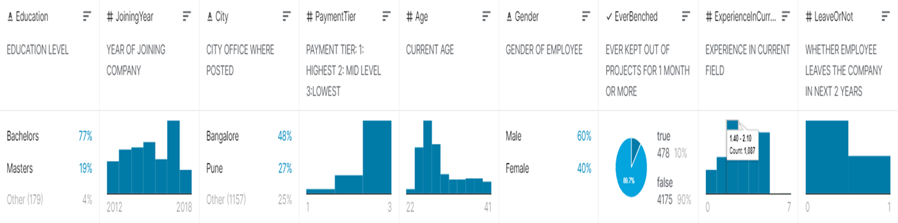
Data Features:

Slide 6
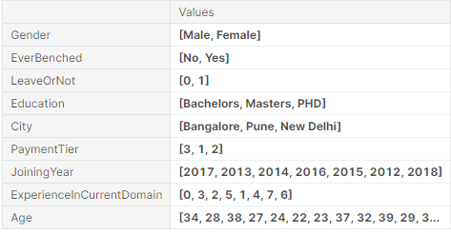
Data info:

Slide 7
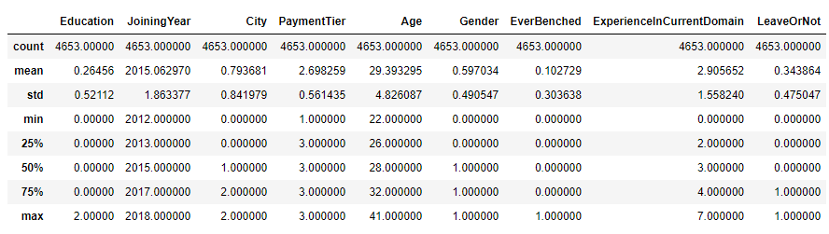
Data description :

Slide 8
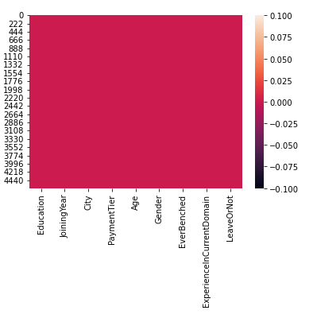

Slide 9
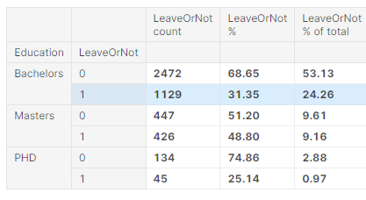
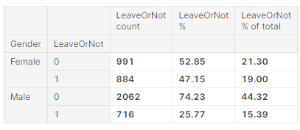
EDA

Slide 10
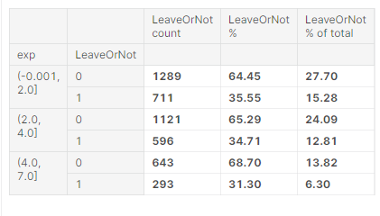
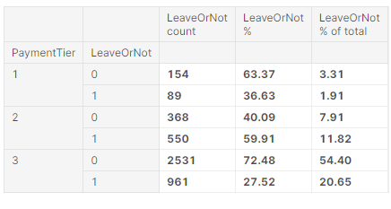

Slide 11
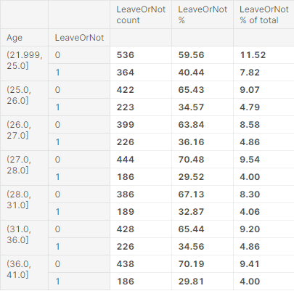
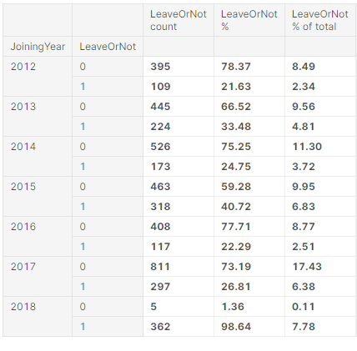

Slide 12
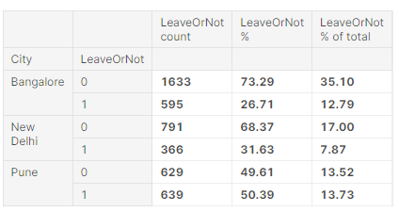
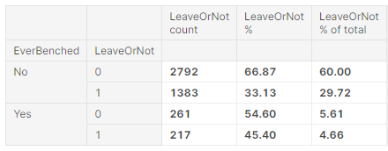

Slide 13
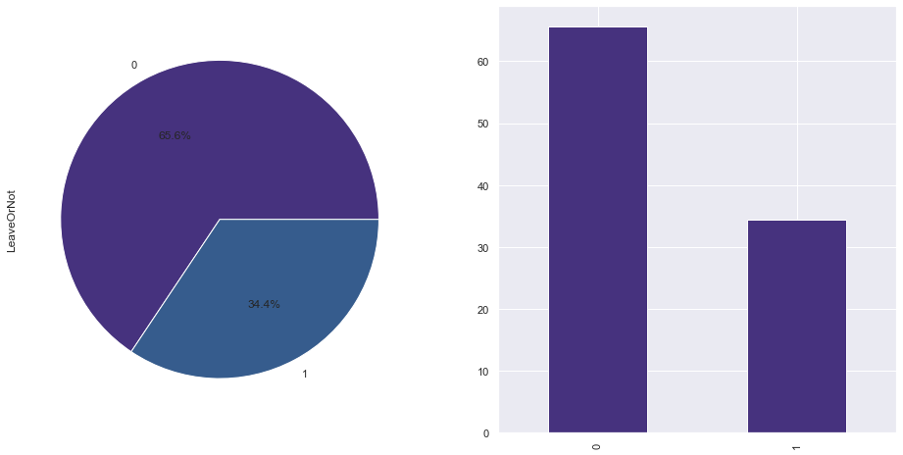
Data Visualization

Slide 14
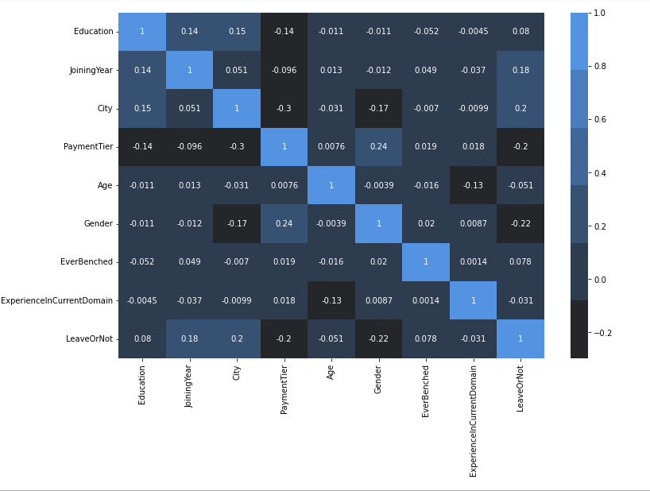

Slide 15
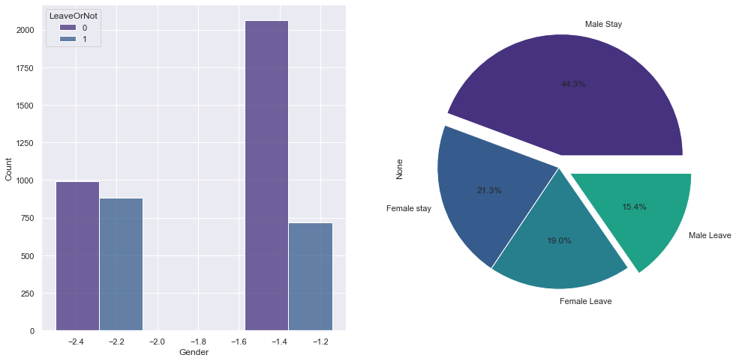
the male employees have the highest rate who won't leave the company (male) with 44% and also have the lowest rate who will leave the company( male) with 15% and the female employees who will leave with 19% and who won't leave with 21%

Slide 16
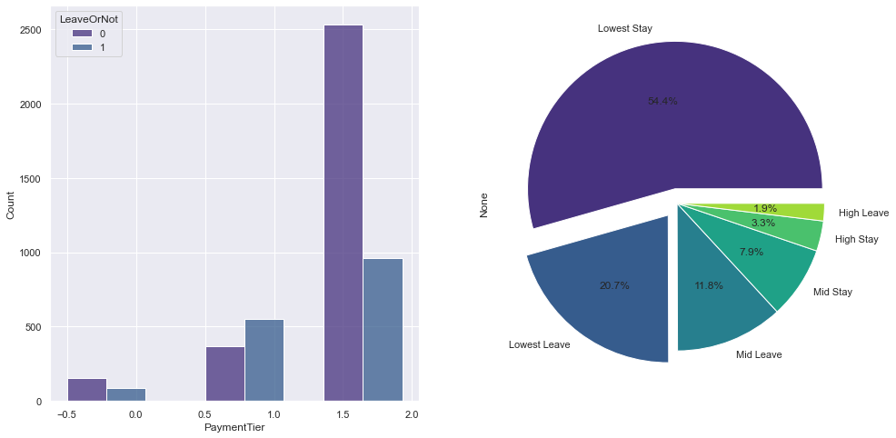
The type of payment tier
-1: HIGHEST
-2: MID LEVEL
-3:LOWEST
the employees who said that they won't leave their tier payment is the lowest than others with 54% and also the employees who said they will leave their tier payment is the lowest than others 20%

Slide 17
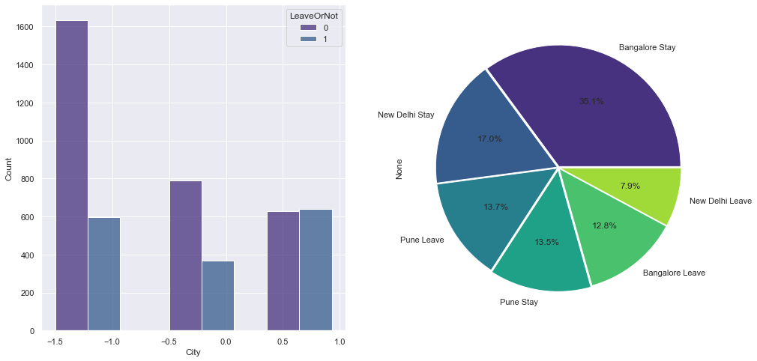
Bangalore is the city with the highest rate where employees said they won't leave the company with 35%
and New Delhi is the city where employees said the will leave but with the lowest rate than other cities
pune city have approx the same rate in leaving and staying

Slide 18
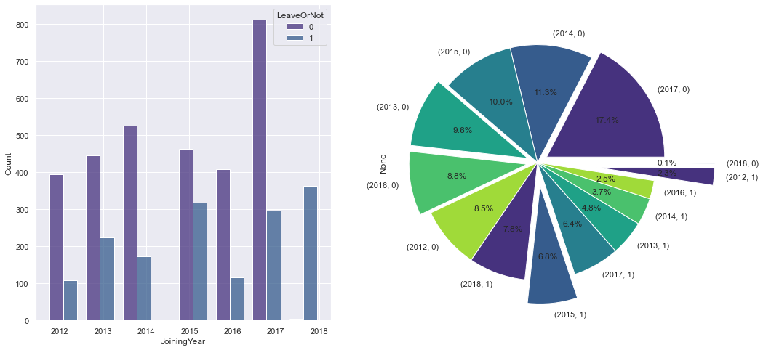
we can notice that 2017 is year when the employee with more than 17% said that they won't leave
and 2018 is the year where employees said that they won't leave but with the lowest rate than others with 0.1%which means that the employees who said in 2017 that they won't leave left!!
and 2012 is the year when employees said they will leave but with the lowest rate than others with 8%
2018 is the year when employees said they will leave but with the highest rate than others with 7.8%
also we can see that the number of employees who said they won't leave in 2018 highly decreased than 2017

Slide 19
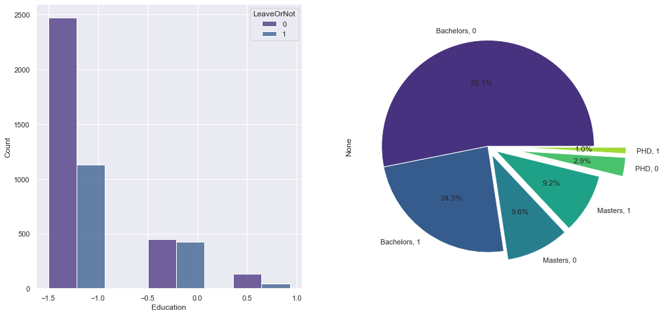
the most employees have bachelors with and more than 53% won't leave and 24% will leave
then more than 9 % have masters won't leave and 9 will leave
then with the lowest rate approx 3% of employees have PHD and won't leave and 1% will leave

Slide 20
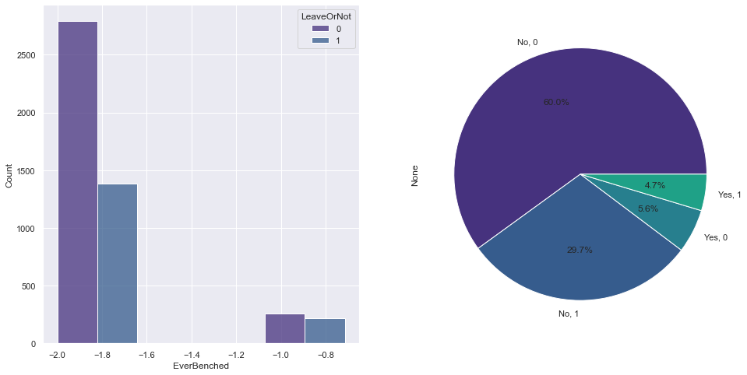
it means ever kept out of the projects for 1 month or more
the people who haven't kept out of the projects for month or more have the highest rate in leaving with 29% and staying with 60%

Slide 21
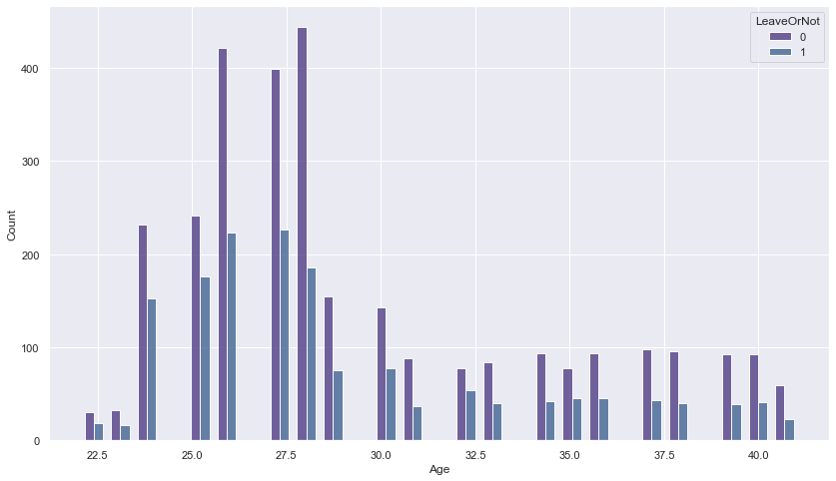
employees with the age 28 said they will leave and won't leave with the highest level than the other ages

Slide 22
ML Models Used
Model
LGBM
KNN
Decision Tree
Random Forest
Gradient Boosting
SVM
Extra Trees
Logistic Regression
Ada Boost
Gaussian NB
Accuracy
87.32%
82.70%
85.21%
86.68%
86.46%
86.35%
85.71%
71.42%
80.02%
68.52%

Slide 23
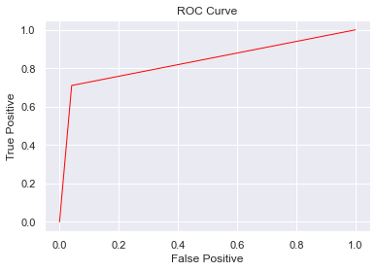
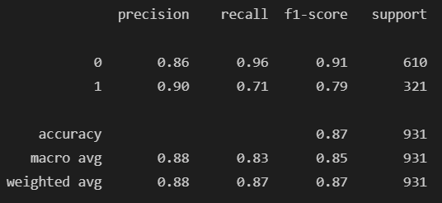
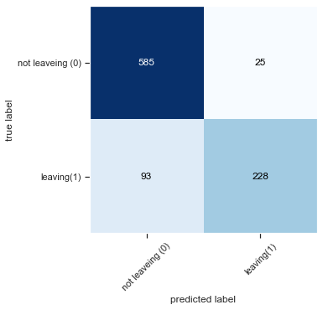
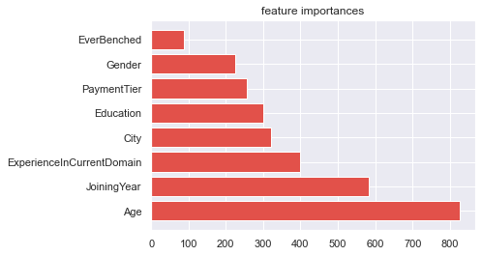
LGBM Classifier
Accuracy: %87.32

Slide 24
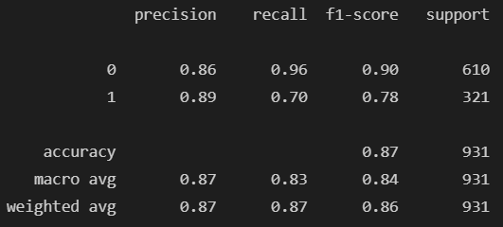

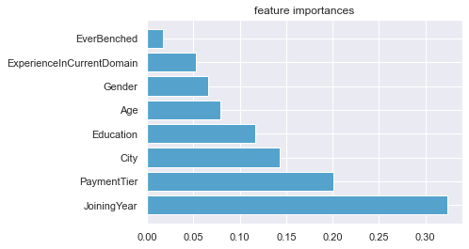
Random Forest Classifier
Accuracy: %86.68

Slide 25
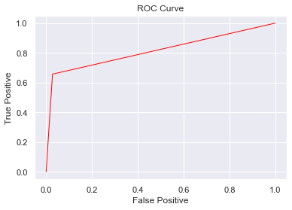
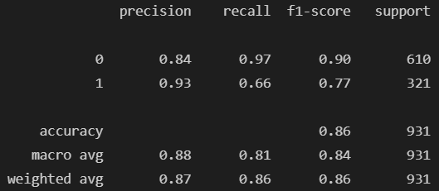
SVM Classifier
Accuracy: %86.35

Slide 26
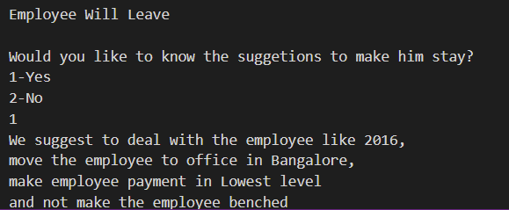
Solution

Slide 27
Thank You

